Slide 1
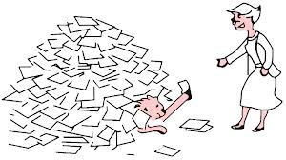
Clustering and Classification algorithms
by
Dr. N. SANDHYA
HOD,CSE

Slide 2

Introduction to clustering
Clustering is also known as unsupervised learning.
Document clustering or Text clustering is the process of grouping documents with similar contents or topics into clusters to improve both availability and reliability of text mining applications
  information retrieval
  text classification
  document summarization , etc.

Slide 3
Clustering techniques
Clustering algorithms are mainly categorized into Partitioning and Hierarchal methods.
Partitioning methods are used to cluster the data into defined number of categories.
1. k-means
2. k-modes
3. k-medoids
Hierarchical clustering method works by grouping data objects into a tree of clusters.
Hierarchical clustering is classified into
agglomerative
divisive

Slide 4
K-means clustering
K-means algorithm uses a similarity measure to deal with the numerical objects and uses a frequency –based method to update means in the clustering process to minimize the clustering cost function.

Slide 5
k-means Algorithm
The basic steps for forming clusters using cross validations are as follows:
Let X = {x₁,x₂,x₃,……..,x_{n}} be the set of data points and V = {v₁,v₂,…….,v_{k}} be the set of centers
Step 1) Randomly select ‘k’ cluster centers.
Step 2) Calculate the distance between each data
point and cluster centers.
Step 3) Assign the data point to the cluster center whose distance from the cluster center is minimum of all the cluster centers.

Slide 6

k-means Algorithm
Step 4)Recalculate the new cluster center using:
where, ‘c_{i}’ represents the number of data points in i^{th} cluster.
Step 5) Recalculate the distance between each data point and new obtained cluster centers.
Step 6) If no data point was reassigned then stop, otherwise repeat from step 2).

Slide 7
k means algorithm problem
The data mining task is to cluster points into three clusters, where the points are
A1(2,10), A2(2,5), A3(8,4), B1(5,8), B2(7,5), B3(6,4) , C1(1,2), C2( 4,9)
The distance function is Manhattan distance. Suppose initially we assign A1 ,B1,C1 as the center of each cluster, use the k-means algorithm to show only
The three clusters after the first round of execution .
The final three clusters

Slide 8
k means algorithm problem
Step1: Choose randomly 3 points.
i.e., A1, B1, C1 are chosen as initial centroids randomly
Therefore CE1=A1, CE2=B1,CE3=C1
Step2: Calculate the distance between each data point and cluster centers.
The distance measure chosen here is Manhattan distance
d(i,j)=|x1 - x2|+|y1 – y2|
Table 2: dissimilarity matrix
points | A1 | A2 | A3 | B1 | B2 | B3 | C1 | C2
CE1 | 0 | 5 | 12 | 5 | 10 | 10 | 9 | 3
CE2 | 5 | 6 | 7 | 0 | 5 | 5 | 10 | 2
CE3 | 9 | 4 | 9 | 10 | 9 | 7 | 0 | 10

Slide 9
k means algorithm problem
Step3: Assign the data point to the cluster center whose distance from the cluster center is minimum among the cluster centers.
(From each column select the minimum value and put the data point in the corresponding clusters)
Table 3: dissimilarity matrix
points | A1 | A2 | A3 | B1 | B2 | B3 | C1 | C2
CE1 | 0 | 5 | 12 | 5 | 10 | 10 | 9 | 3
CE2 | 5 | 6 | 7 | 0 | 5 | 5 | 10 | 2
CE3 | 9 | 4 | 9 | 10 | 9 | 7 | 0 | 10
A1
A3
B1
B2
B3
C2
CE3
A2
C1
CE1
CE2

Slide 10
k means algorithm problem
Step 4: Recalculate the new cluster centers
(i.e., calculate the average of all the points in that cluster and the resulting point will become the new centroid of the cluster)
The new CE1=A1 because there is only point (CE1= A1(2,10))
CE2= Calculate the average of A3(8,4), B1(5,8), B2(7,5),
B3(6,4) , C2( 4,9)
therefore CE2=((8+5+7+6+4)/5, (4+8+5+4+9)/5)=(6,6)
CE3= Calculate the average of A2(2,5), C1(1,2)
therefore CE3=((2+1)/2,(5+2)/2)=(1.5,3.5)
Table 4: dissimilarity matrix
points | A1 (2,10) | A2 (2,5) | A3 (8,4) | B1 (5,8) | B2 (7,5) | B3 (6,4) | C1 (1,2) | C2 ( 4,9)
CE1=(2, 10) | 0 | 5 | 12 | 5 | 10 | 10 | \ 9 | 3
CE2=(6, 6) | 8 | 5 | 4 | 3 | 2 | 2 | 9 | 5
CE3=(1.5, 3.5) | 7 | 2 | 7 | 8 | 7 | 5 | 2 | 8

Slide 11
k means algorithm problem
A1
C2
CE1
CE2
A3
B1
B2
B3
CE3
A2
C1
Step 5: Recalculate the distance between each data point and new obtained cluster centers.
Step 6: If no data point was reassigned then stop, otherwise repeat from step 2).
But in the example the objects are reassigned so continue from step 2.
(i.e., calculate the average of all the points in that cluster and the resulting point will become the new centroid of the cluster)
The new CE1=Calculate the average of A1(2,10),C2(4,9)
Therefore CE1=(2+4)/2,(10+9)/2)=(3,8.5)
CE2= Calculate the average of A3(8,4), B1(5,8), B2(7,5),
B3(6,4)
therefore CE2=((8+5+7+6)/4, (4+8+5+4)/4)=(6.5,5.2)
CE3= Calculate the average A2(2,5), C1(1,2)
therefore CE3=((2+1)/2,(5+2)/2)=(1.5,3.5)

Slide 12
k means algorithm problem
Table 4: dissimilarity matrix
points | A1 (2,10) | A2 (2,5) | A3 (8,4) | B1 (5,8) | B2 (7,5) | B3 (6,4) | C1 (1,2) | C2 ( 4,9)
CE1=(3,8.5) | 2.5 | 4.5 | 9.5 | 2.5 | 7.5 | 7.5 | \ 8.5 | 1.5
CE2=(6.5, 5.2) | 9.3 | 4.7 | 3.7 | 4.3 | 0.7 | 1.7 | 8.7 | 6.3
CE3=(1.5, 3.5) | 7 | 2 | 7 | 8 | 7 | 5 | 2 | 8
A1
B1
C2
CE1
CE2
A3
B2
B3
CE3
A2
C1

Slide 13
k means algorithm problem
Step 4: Recalculate the new cluster centers
(i.e., calculate the average of all the points in that cluster and the resulting point will become the new centroid of the cluster)
The new CE1=Calculate the average of A1(2,10),B1(5,8),C2(4,9)
Therefore CE1=(2+5+4)/3,(10+8+9)/3)=(3.6,9)
CE2= Calculate the average of A3(8,4), B2(7,5), B3(6,4)
therefore CE2=((8+7+6)/3, (4+5+4)/3)=(7,4.3)
CE3= Calculate the average A2(2,5), C1(1,2)
therefore CE3=((2+1)/2,(5+2)/2)=(1.5,3.5)
Table 4: dissimilarity matrix
points | A1 (2,10) | A2 (2,5) | A3 (8,4) | B1 (5,8) | B2 (7,5) | B3 (6,4) | C1 (1,2) | C2 ( 4,9)
CE1=(3.6,9) | 2.6 | 5.6 | 9.4 | 2.4 | 7.4 | 7.4 | \ 9.6 | 0.4
CE2=(7,4.3) | 11.7 | 5.7 | 1.3 | 5.7 | 0.7 | 1.3 | 6.3 | 7.7
CE3=(1.5, 3.5) | 7 | 2 | 7 | 8 | 7 | 5 | 2 | 8

Slide 14
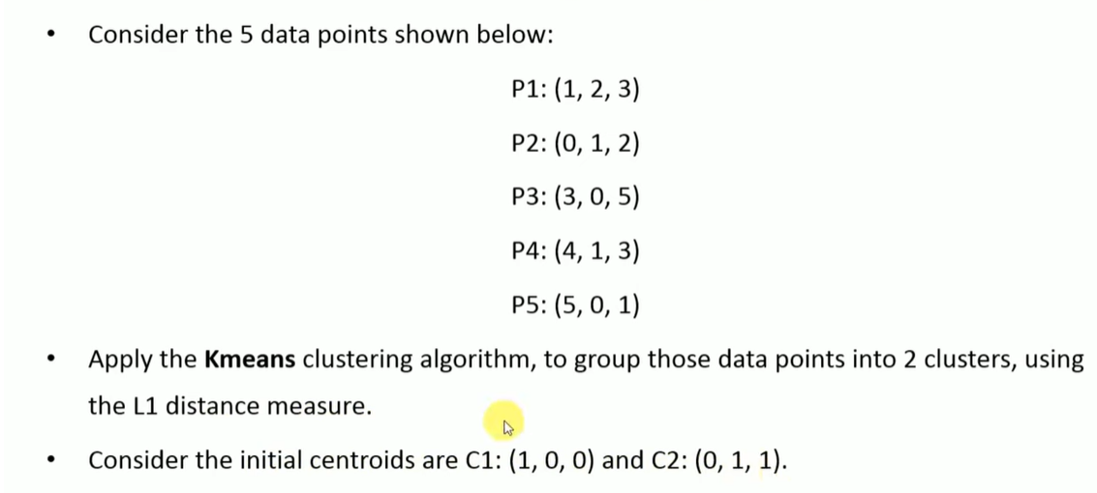

Slide 15
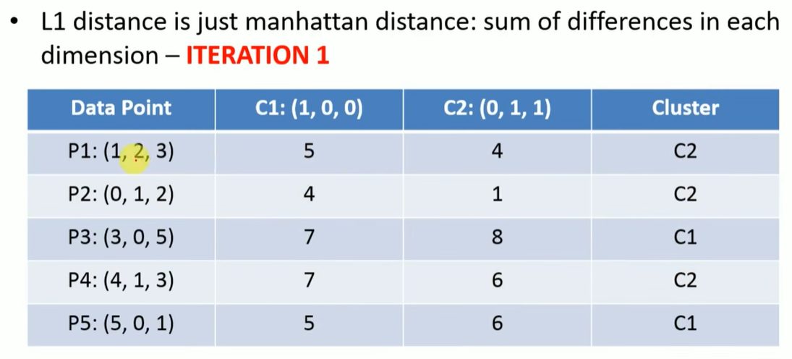

Slide 16
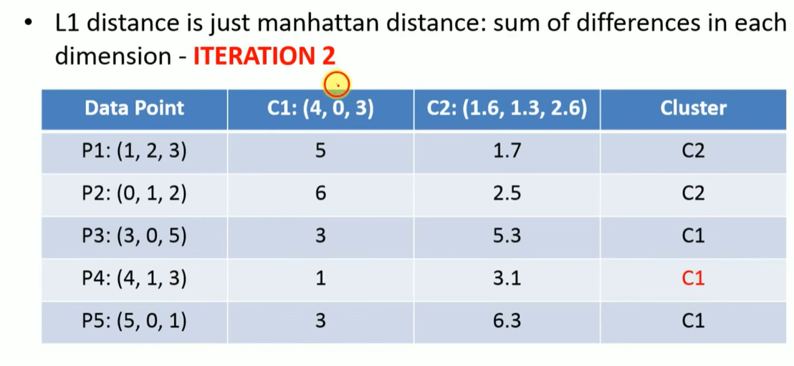

Slide 17
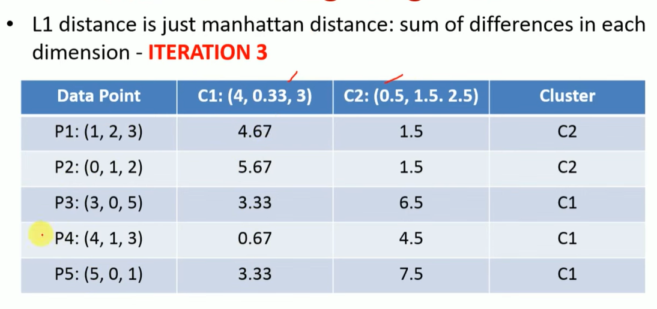

Slide 18
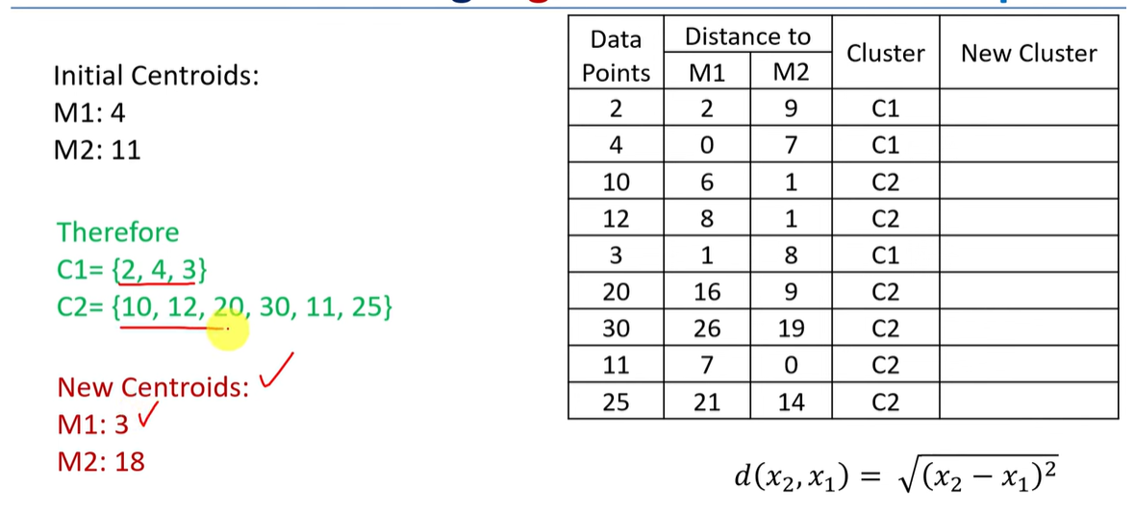

Slide 19
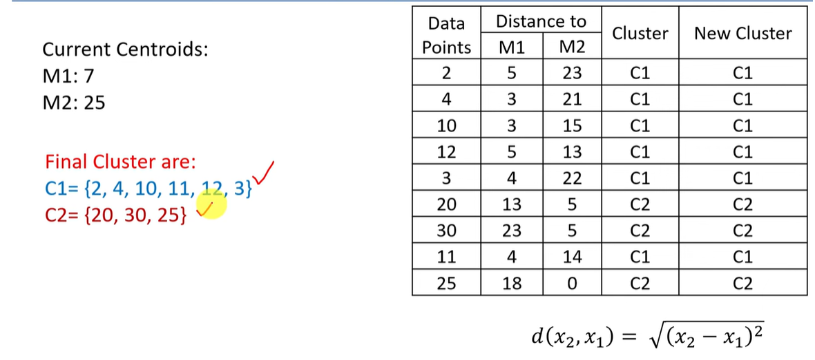

Slide 20
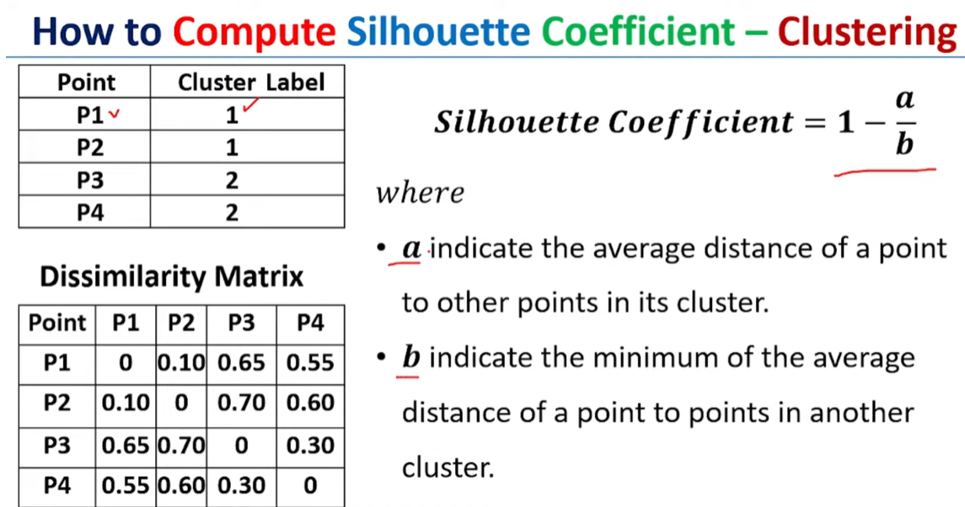

Slide 21
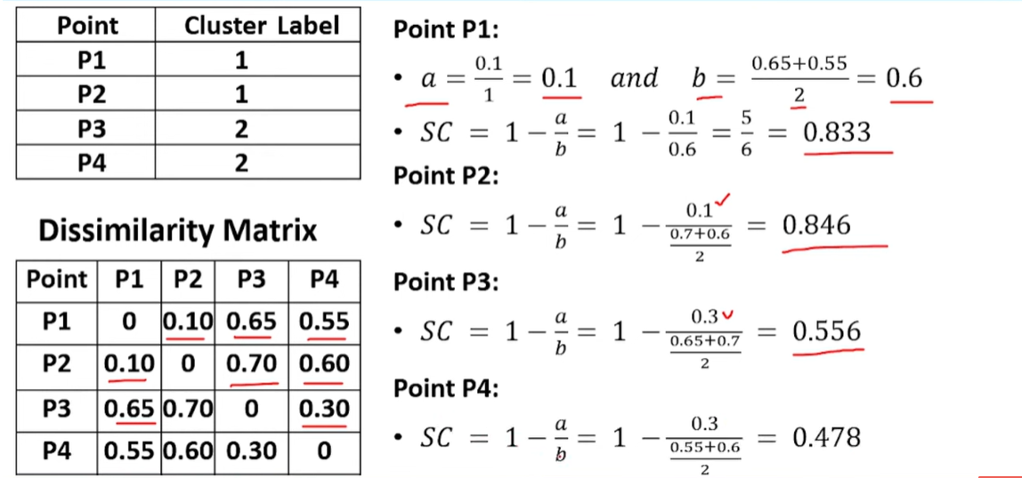

Slide 22
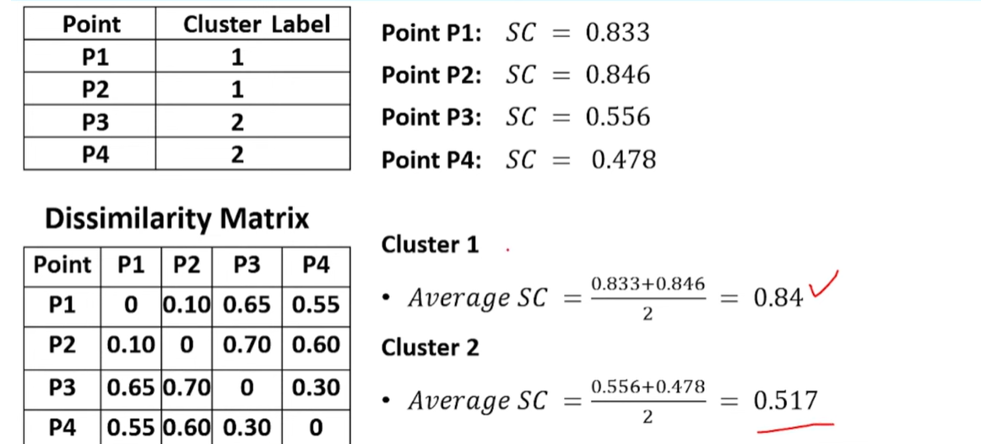

Slide 23
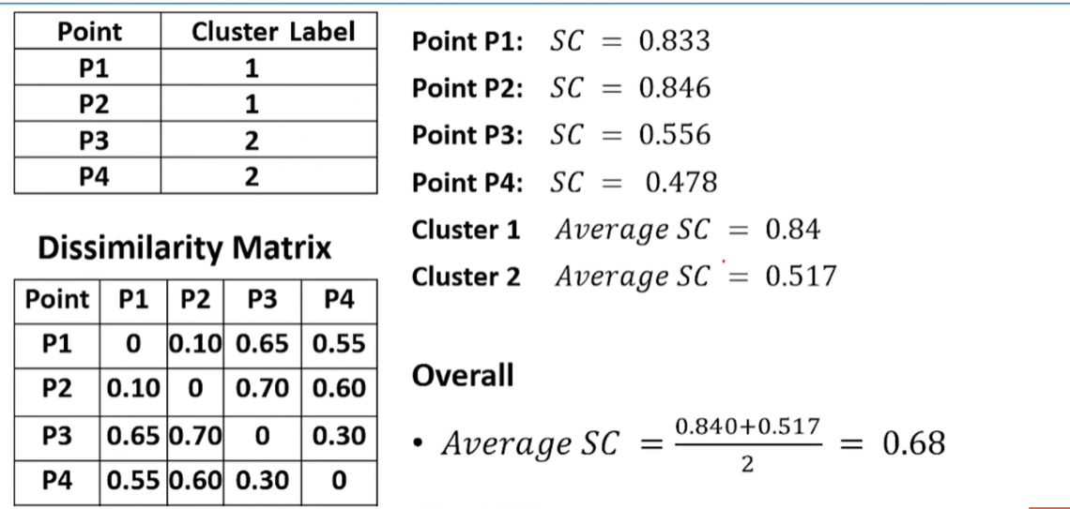

Slide 24
k means algorithm problem
The objects are not reassigned so halt
A1
B1
C2
CE2
A3
B2
B3
A2
C1
CE1
CE3

Slide 25
k-modes algorithm
Step 1: arbitrarily choose k objects as modes of the cluster initialy
Step 2: (re) Assign the objects to the cluster based on the similarity between the mode and object.
Step 3: find the mode after clustering all the objects is step 2.
Procedure for finding the mode:Consider the objects in the cluster and find the most frequently repeated attribute value in that cloumn and assign them as the corresponding mode (same for all the attributes).
Step 4: Repeat step 2 and 3 until we get the same clusters in the two consecutive iterations.

Slide 26
k-modes algorithm problem
Objects | Income | Age | STUDENT
1 | Low | Middle | No
2 | High | Senior | No
3 | Low | Youth | Yes
4 | Medium | Youth | Yes
5 | High | Middle | No
6 | High | Youth | No
Step1 : select 2 objects from the 6 objects as the initial modes
(i.e., we have choosen O1, O4 as intial model)
So our modes are (Low, Middle, No) and (Medium, Youth, Yes)
Step 2: Assign the objects to the cluster based on the similarity between the mode and object.
Ex for finding the distance between (low,medium,no) and (high ,senior, no)=
(low-high)+(medium-senior)+(no-no) = (1+1-0)=2
In the same way find the distance between the objects and modes.

Slide 27
k-modes algorithm problem
Objects Modes | 01 | 02 | 03 | 04 | 05 | 06
M1=01 | 0 | 2 | 2 | 3 | 1 | 2
M2=04 | 3 | 3 | 1 | 0 | 3 | 2
Step 2: Assign the objects to the cluster based on the similarity between the mode and object.
O1
O2
O5
O3
O4
O6
M1
M2

Slide 28
k-modes algorithm problem
O1
O2
O5
M1
Step 3: find the mode after clustering all the objects is step 2.
In the cluster 1 we have O1,O2,O5
Objects | Income | Age | STUDENT
1 | Low | Middle | No
2 | High | Senior | No
5 | High | Middle | No
New mode 1 | High | Middle | No
M2
O3
O4
O6
In the cluster 2 we have O3,O4,O6
Objects | Income | Age | STUDENT
3 | Low | Youth | Yes
4 | Medium | Youth | Yes
6 | High | Youth | No
New mode 2 | High | Youth | yes

Slide 29
k-modes algorithm problem
Step 2: re Assign the objects to the cluster based on the similarity between the mode and object.
Objects Modes | 01 | 02 | 03 | 04 | 05 | 06
M1 | 1 | 2 | 3 | 3 | 0 | 2
M2 | 3 | 2 | 1 | 1 | 2 | 1
O1
O2
O5
M2
O3
O4
O6
M1
Step 4: the clusters are same in the consecutive iterations So halt

Slide 30
Density based clustering(DBSCAN)
DBSCAN
( Density based spatial clustering of Applications of Noise)
Step 1: select an un clustered object randomly from the dataset
Step 2: check whether it is a core object. if it is a core object then goto step 3 otherwise goto step1 and mark it as a noise
An object is a core object if it has minimum number of neighborhoods otherwise it is a noise object
Step 3: add directly density reachable objects in candidate dataset.
Step 4: Remove an object from the candidate data set and go to step 2 . Repeat this process until the candidate set is not empty.
Step 6: the object that are directly density reachable and density reachable from the core objects are grouped together to form the cluster(i.e., the objects that are stored in the candidate dataset)
Step 5:.repaet from step 1 to step 4 until all objects are clustered or marked as noise.

Slide 31
Density based clustering(DBSCAN)
Ɛ Neighborhood: the objects that lie within the Ɛ radius is a neighborhood.
directly density reachable: the objects that are reachable directly from the core object is called directly density reachable.
density reachable: the objects that are reachable from the directly density reachable objects are called density reachable objects.
Consider the following objects and cluster the objects using DBSCAN with minpoints=5 and radius=3.
A1(2,10), A2(3,7), A3(4,9), A4(2,8), A5(5,8), A6(4,6), A7(2,5), A8(6,4), A9(8,4), A10(7,5), A11(1,2),

Slide 32
Density based clustering(DBSCAN)
Step 1: A2 object is selected
 | A1 | A2 | A3 | A4 | A5 | A6 | A7 | A8 | A9 | A10 | A11
A2 | 4 | 0 | 3 | 2 | 3 | 2 | 3 | 7 | 6 | 8 | 6
Step 2: check whether A2 is a core object
A2 is a core object because A3,A4,A5,A6,A7 are in the neighborhood of A2(minpts=5 satisfied)

Slide 33
Density based clustering(DBSCAN)
Step 3: add directly density reachable objects in candidate dataset.
A3,A4,A5,A6,A7 are directly density reachable from A2. (A2,A3,A4,A5,A6,A7 forms a cluster)

Slide 34
Density based clustering(DBSCAN)
Step 4: A3 is removed from candidate data set.
Step 2:
 | A1 | A2 | A3 | A4 | A5 | A6 | A7 | A8 | A9 | A10 | A11
A3 | 3 | 3 | 0 | 3 | 2 | 3 | 6 | 9 | 6 | 9 | 7
Step 3: add directly density reachable objects in candidate dataset.
A1,A4,A5,A6,A7 add A1 to candidate data set because A1 is density reachable from A2

Slide 35
Density based clustering(DBSCAN)
Continue the same process for all the objects in the candidate data set.
When the candidate dataset is empty.
Then repeat the procedure for the other objects.
Step 1: A10 is selected
Step 2: A10 is not a core object. So A10 is a noise object and goto step 1.
Repeat the procedure for all the objects.

Slide 36

Thank you

